Slide 1
ECE 526 Final Project Presentation
By: Daniel Celnik
Instructor: orod haghighiara
External memory controller for ddr

Slide 2
AGENDA
DDR3 Introduction
Project Overview
Design Methodology and Results (4 Versions)
Conclusion
References
Appendix

Slide 3
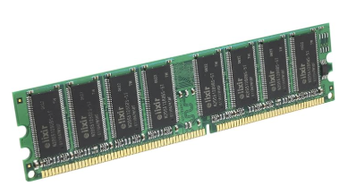
Introduction
What is DDR3?
Double Data Rate Type 3 Synchronous Dynamic Random-Access Memory (SDRAM)
Key DDR3 Characteristics:
High throughput (Gb/s bandwidth)
Burst-oriented access
Pipelined architecture
Why Model DDR3 Behavior?
Understanding latency, burst operations, and FIFO queueing
Preparing for FPGA or SoC integration

Slide 4
Project Overview
What I Implemented:
Key Features:
End Result:
Behavioral DDR3 model simulating latency and burst responses
Burst-capable memory controller FSM for read/write access
Register-based front-end interface (like AXI-lite bus protocol style control)
Automated stress testbench verifying hundreds of burst transactions
4-word burst support
Latency measurement
Pseudo-random pattern generation (XOR)
CPU-style register access
Exhaustive pass/fail tracking
A modular, realistic memory system
Fully automated simulation with success/failure reporting
Expandable for future AXI-lite or custom bus systems

Slide 5
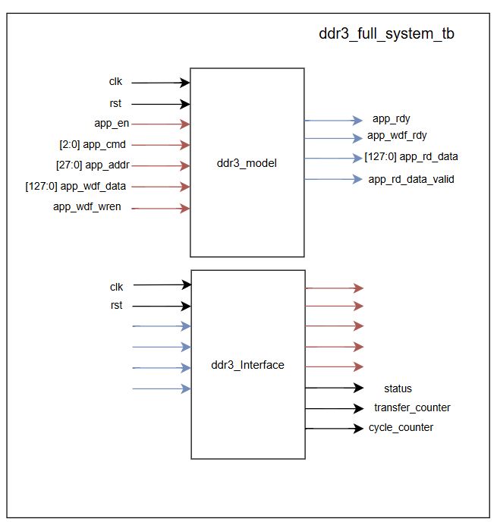
Version 1 - Concept
ddr3_module:
  The memory module itself
ddr3_interface:
  Cross-coupled with ddr3_module
  Acts as a master controller for the memory
ddr3_full_system_tb:
  top-level module that instantiates and simulates the memory + controller system

Slide 6
Implementation
ddr3_module:
  Reset, read, and write capabilities
  Enabled via control signals from ddr3_interface
  Read command has hardcoded latency
ddr3_interface:
  FSM STATES: idle, write, write_wait, read, read_wait, compare
IDLE: generates expected data via fixed value ^ address
WRITE: Signals ddr3_module to write data
WRITE_WAIT: waits one clock cycle to ensure stability
READ: Signals ddr3_module to read data
READ_WAIT: Waits for ddr3_module to return data
COMPARE: compares read data with expected data

Slide 7
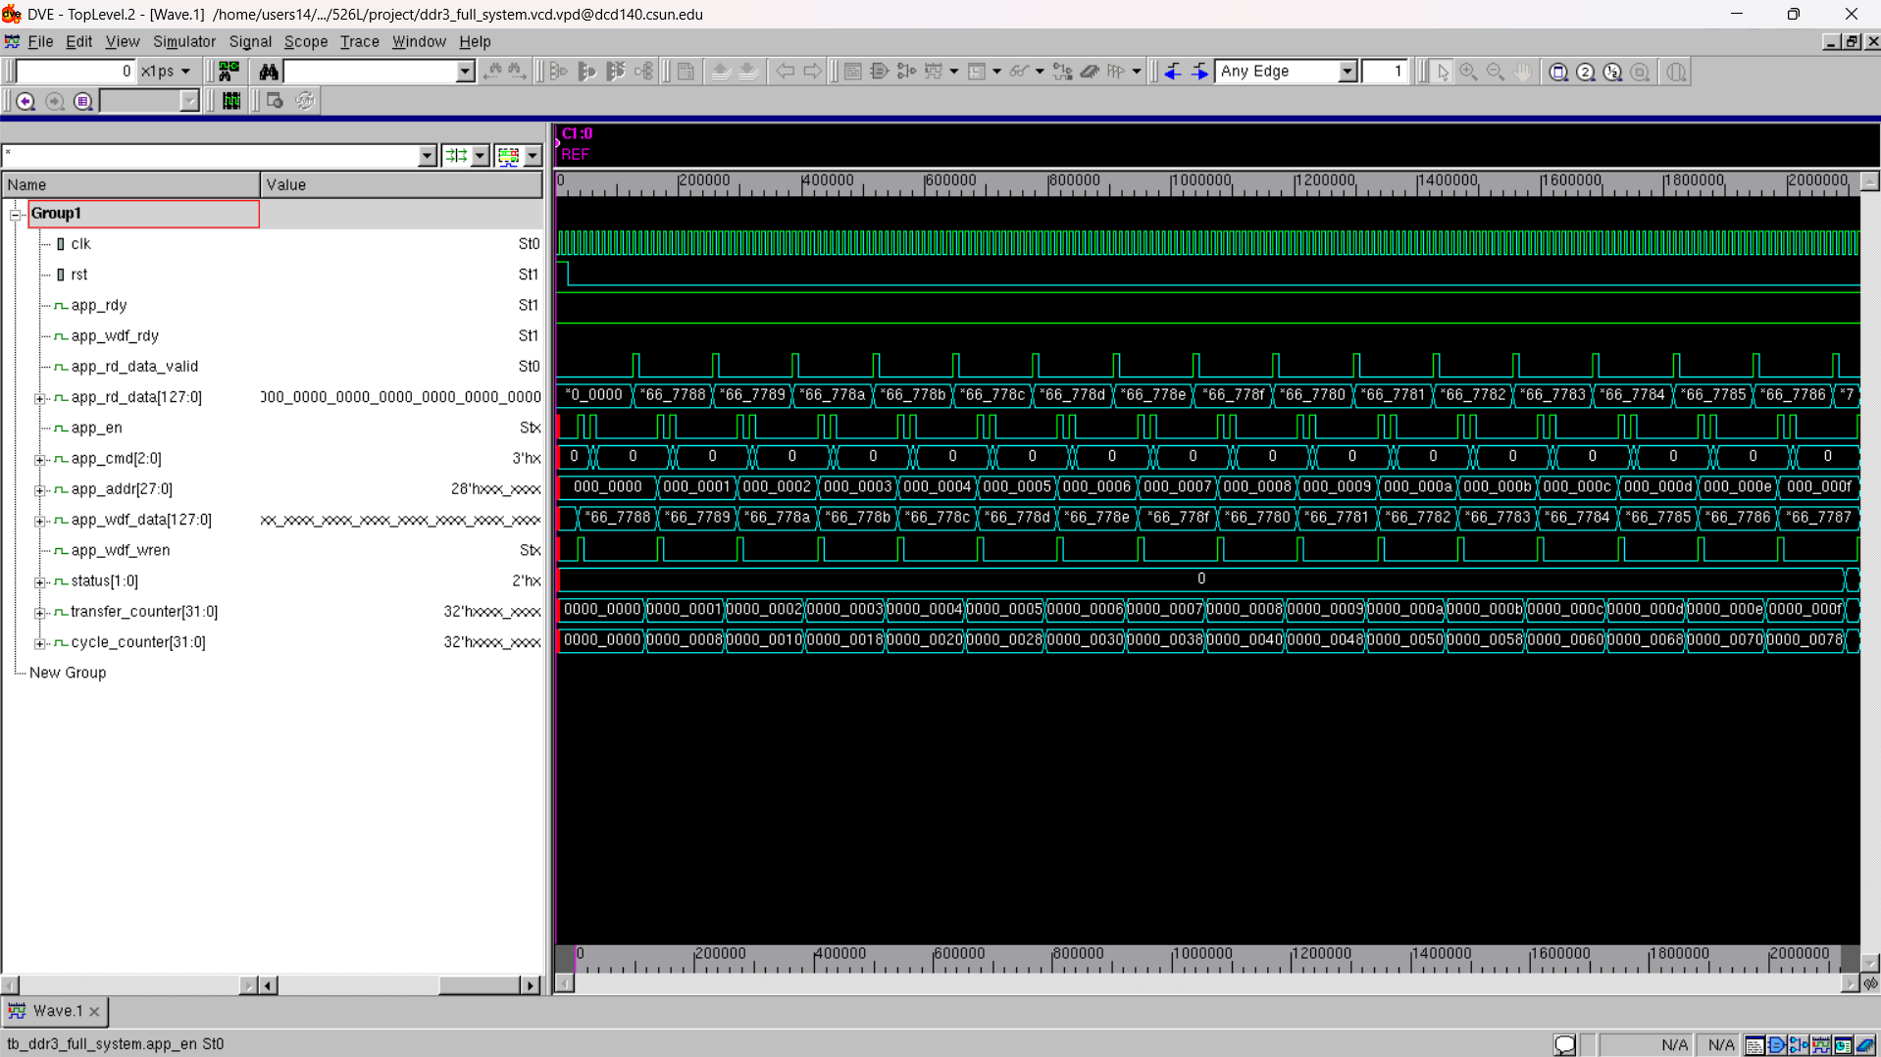
simulation results
Starting full DDR3 system simulation...
[DDR3_MODEL] WRITE to addr 0x0000000 = 0xcafebabedeadbeef1122334455667788
[DDR3_MODEL] READ request for addr 0x0000000
[DDR3_MODEL] READ response from addr 0x0000000 = 0xcafebabedeadbeef1122334455667788
[DDR3_MODEL] WRITE to addr 0x0000001 = 0xcafebabedeadbeef1122334455667789
[DDR3_MODEL] READ request for addr 0x0000001
[DDR3_MODEL] READ response from addr 0x0000001 = 0xcafebabedeadbeef1122334455667789
.
.
[DDR3_MODEL] WRITE to addr 0x000001f = 0xcafebabedeadbeef1122334455667797
[DDR3_MODEL] READ request for addr 0x000001f
[DDR3_MODEL] READ response from addr 0x000001f = 0xcafebabedeadbeef1122334455667797
✅ TEST PASSED: All transfers correct.
Transfers: 32, Total Latency: 256 cycles, Avg Latency: 8.00

Slide 8
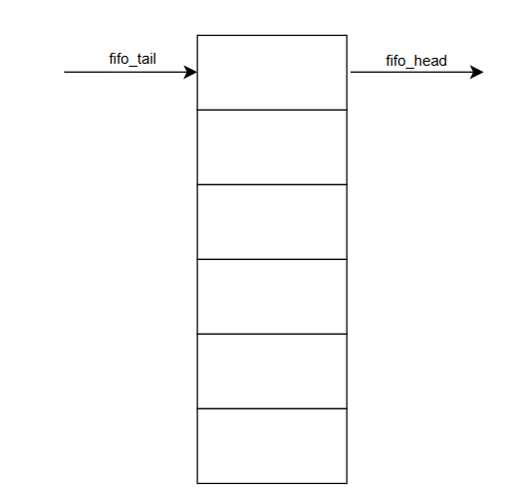
Version 2 - Concept
Added Burst Read/Write Support
ddr3_module:
  Added FIFO to handle queuing of bursts
ddr3_interface:
  FSM STATES: idle, write, write_burst, wait_before_read, read, read_burst, compare

Slide 9
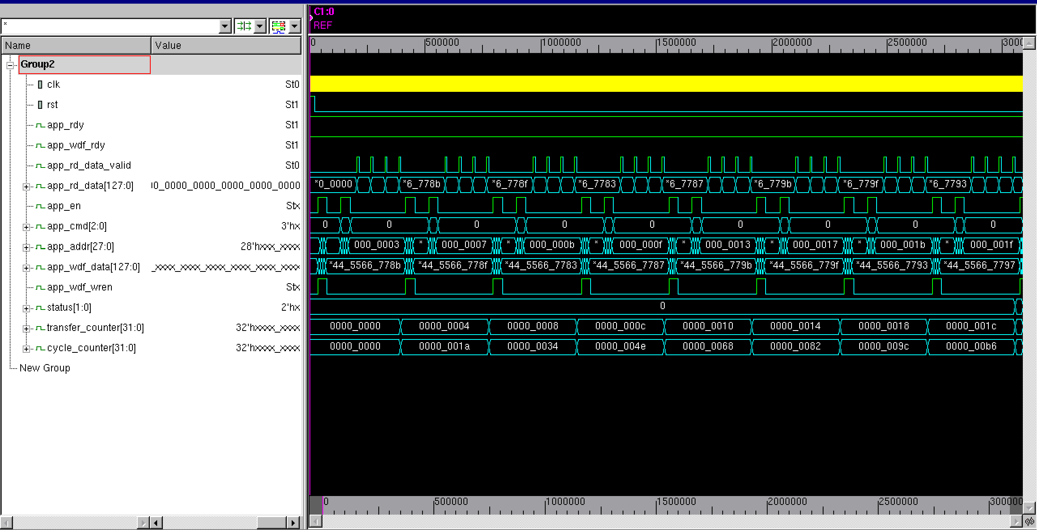
simulation results - Waves

Slide 10
simulation results - log
Starting full DDR3 system simulation with burst support...
== New Burst @ Address 0x00000000 ==
[WRITE] Addr: 0x00000000 Data: 0xcafebabedeadbeef1122334455667788
[WRITE] Addr: 0000000 Data: cafebabedeadbeef1122334455667788
[WRITE] Addr: 0x00000001 Data: 0xcafebabedeadbeef1122334455667789
[WRITE] Addr: 0000001 Data: cafebabedeadbeef1122334455667789 [WRITE] Addr: 0x00000002 Data: 0xcafebabedeadbeef112233445566778a
[WRITE] Addr: 0000002 Data: cafebabedeadbeef112233445566778a [WRITE] Addr: 0x00000003 Data: 0xcafebabedeadbeef112233445566778b
[WRITE] Addr: 0000003 Data: cafebabedeadbeef112233445566778b
[READ ] Starting burst read @ Address 0x00000000
[READ ] Addr: 0000000
[READ ] Addr: 0000001
[READ ] Addr: 0000002
[READ ] Addr: 0000003
[RD_VALID] Data: cafebabedeadbeef1122334455667788
[READ ] Addr: 0x00000000 OK Data: 0xcafebabedeadbeef1122334455667788
[RD_VALID] Data: cafebabedeadbeef1122334455667789
[READ ] Addr: 0x00000001 OK Data: 0xcafebabedeadbeef1122334455667789
[RD_VALID] Data: cafebabedeadbeef112233445566778a
[READ ] Addr: 0x00000002 OK Data: 0xcafebabedeadbeef112233445566778a
[RD_VALID] Data: cafebabedeadbeef112233445566778b
[READ ] Addr: 0x00000003 OK Data: 0xcafebabedeadbeef112233445566778b
\n== New Burst @ Address 0x00000004 ==
.
.
[RD_VALID] Data: cafebabedeadbeef1122334455667794
[READ ] Addr: 0x0000001c OK Data: 0xcafebabedeadbeef1122334455667794
[RD_VALID] Data: cafebabedeadbeef1122334455667795
[READ ] Addr: 0x0000001d OK Data: 0xcafebabedeadbeef1122334455667795
[RD_VALID] Data: cafebabedeadbeef1122334455667796
[READ ] Addr: 0x0000001e OK Data: 0xcafebabedeadbeef1122334455667796
[RD_VALID] Data: cafebabedeadbeef1122334455667797
[READ ] Addr: 0x0000001f OK Data: 0xcafebabedeadbeef1122334455667797
✅ TEST PASSED: All transfers correct.
Transfers: 32, Total Latency: 208 cycles, Avg Latency: 6.50

Slide 11
Version 3 - Concept
Added Register-Based Front-End
ddr3_module:
  No changes
ddr3_interface_regctrl:
  New reg: read_trigger and write_trigger
  FSM updated: idle, issue_write, issue_write_burst, wait_before_read, issue_read, issue_read_burst, complete
ddr3_top:
  Sets read_trigger and write_trigger high to begin read/writes
FSM used to cycle through all its states
Now, triggering write_trigger causes:
  idle->issue_write->issue_write_burst->wait_before_read->complete->idle
Triggering read_trigger causes:
  idle->issue_read->issue_read_burst->complete->idle

Slide 12
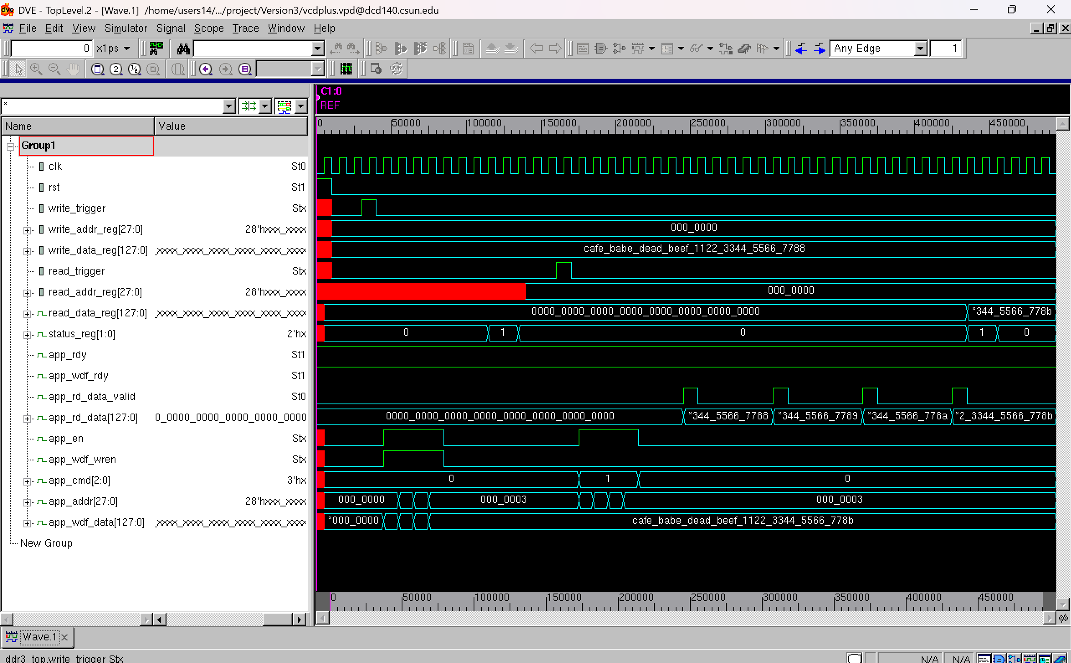
simulation results - waves

Slide 13
Simulation Results - log
Starting full DDR3 register interface test...
[REGCTRL] Write trigger received. Starting burst write at addr 0x00000000
[REGCTRL] WRITE 0x00000000 = 0xcafebabedeadbeef1122334455667788
[REGCTRL] WRITE 0x00000001 = 0xcafebabedeadbeef1122334455667789
[REGCTRL] WRITE 0x00000002 = 0xcafebabedeadbeef112233445566778a
[REGCTRL] WRITE 0x00000003 = 0xcafebabedeadbeef112233445566778b
[REGCTRL] Write burst complete.
[REGCTRL] Returning to IDLE.
[REGCTRL] Read trigger received. Starting burst read at addr 0x00000000
[REGCTRL] READ request for addr 0x00000000
[REGCTRL] READ request for addr 0x00000001
[REGCTRL] READ request for addr 0x00000002
[REGCTRL] READ request for addr 0x00000003
[REGCTRL] READ OK Addr: 0x00000000 Data: 0xcafebabedeadbeef1122334455667788
[REGCTRL] READ OK Addr: 0x00000001 Data: 0xcafebabedeadbeef1122334455667789
[REGCTRL] READ OK Addr: 0x00000002 Data: 0xcafebabedeadbeef112233445566778a
[REGCTRL] READ OK Addr: 0x00000003 Data: 0xcafebabedeadbeef112233445566778b
[REGCTRL] Burst read complete and verified.
Final Read Result: cafebabedeadbeef112233445566778b
Status: 01[REGCTRL] Returning to IDLE.

Slide 14
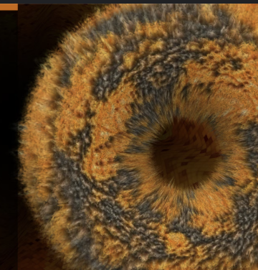
Version 4 - concept
Added Exhaustive Testbench
  64 bursts spanning 256 addresses
  128’b data pattern = {96'hCAFEBABEDEADBEEF11223344 ^ i, 32’b i ^ (i << 2)};
No changes to other modules

Slide 15
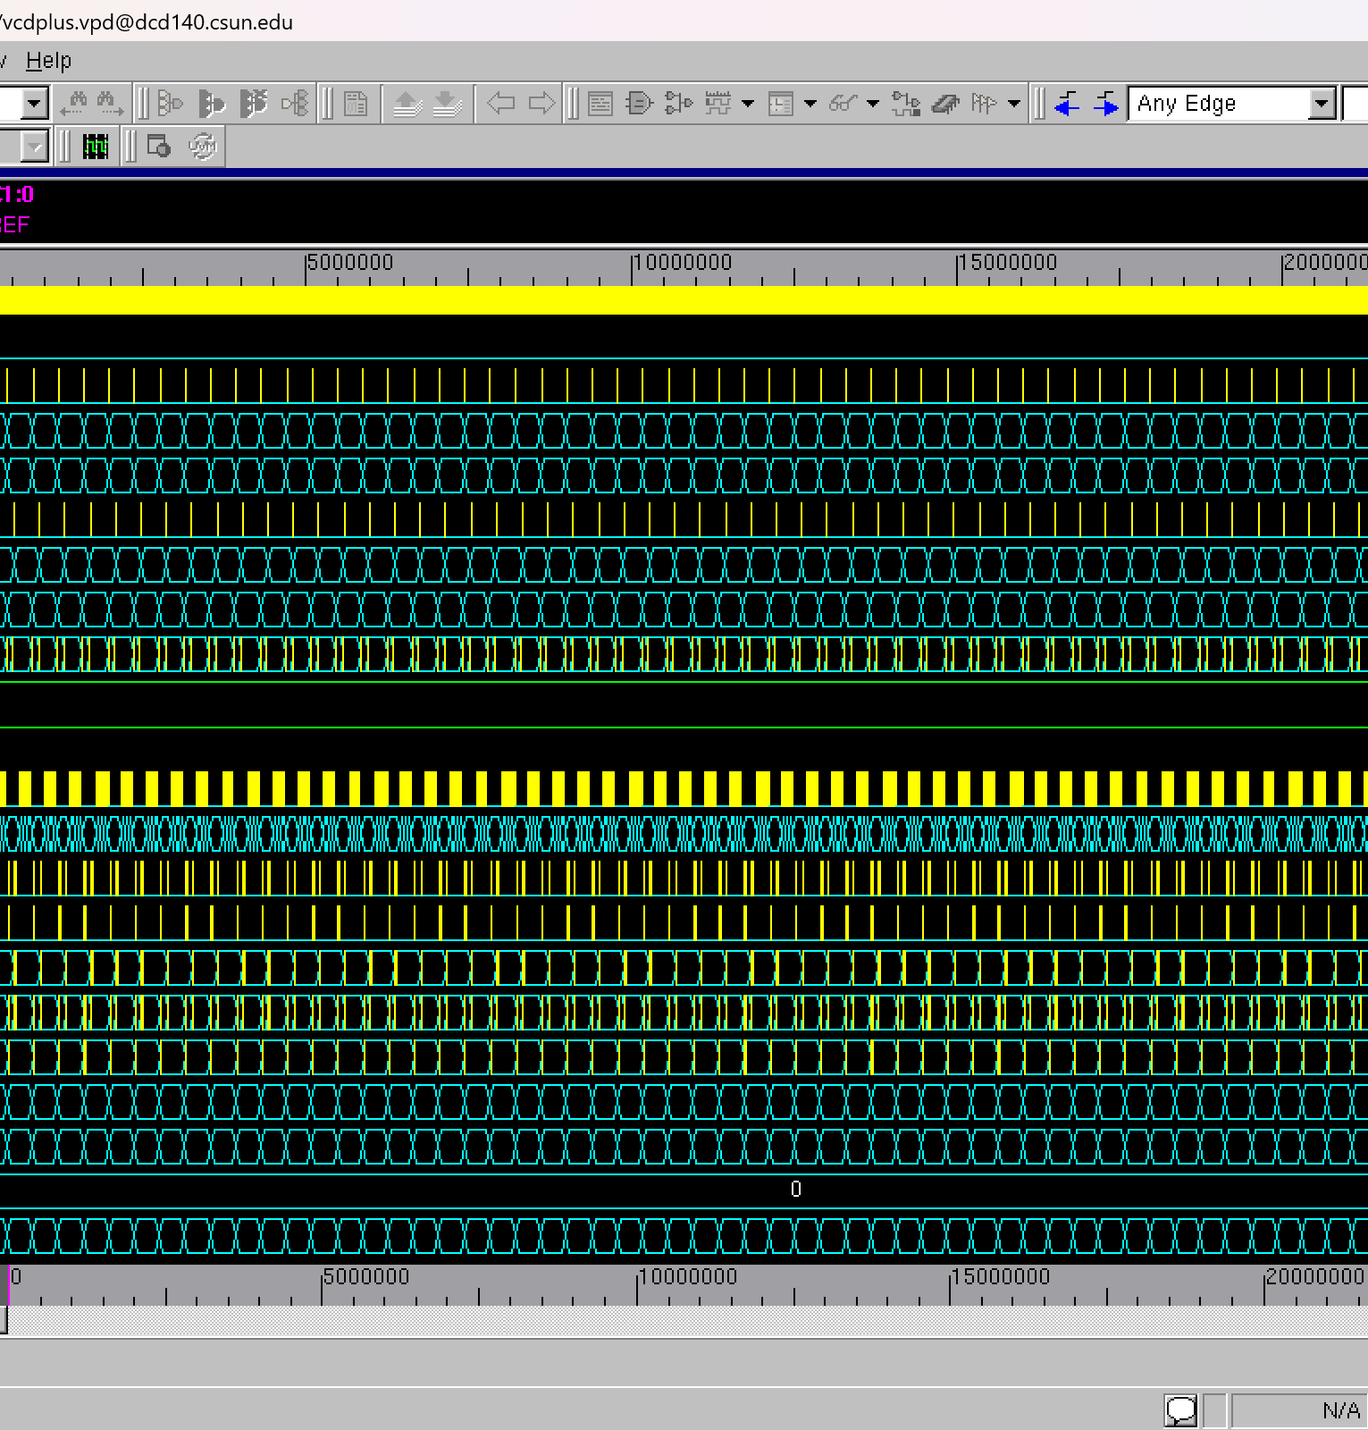
simulation results

Slide 16
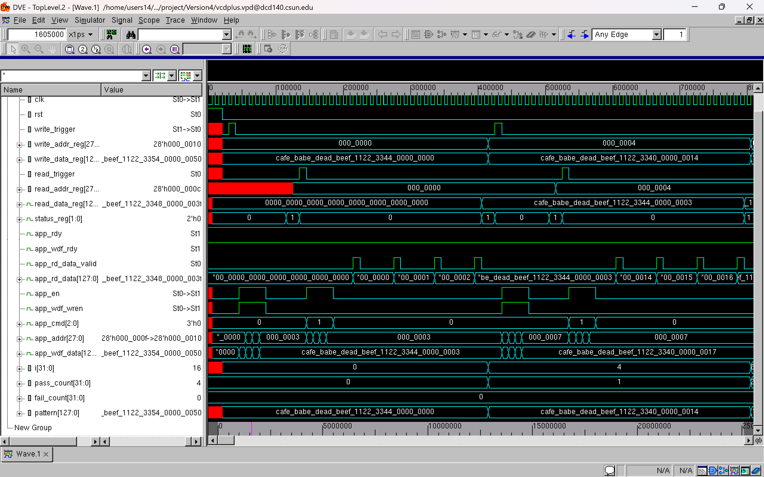
Waves for the first two bursts

Slide 17
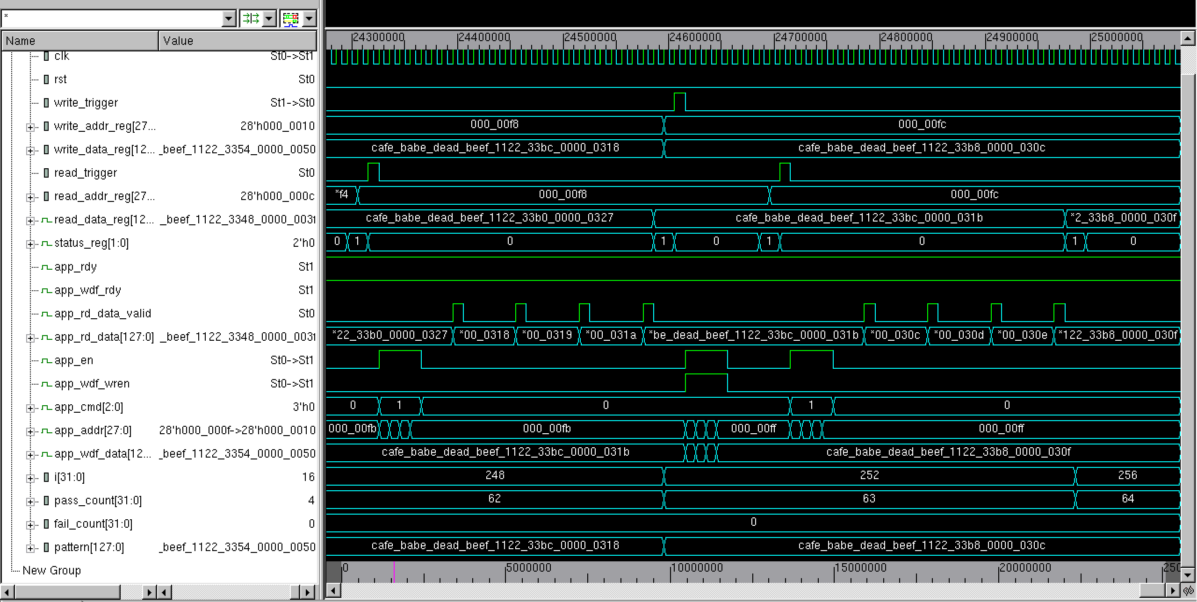
Waves for the last two bursts

Slide 18
conclusion
Version | Description | Major Additions
Version 1: Basic Single Transfer FSM | - FSM: S_IDLE → S_WRITE → S_WRITE_WAIT → S_READ → S_READ_WAIT → S_COMPARE | 🔸 Basic read/write logic 🔸 Latency measurement per word
Version 2: Burst Read/Write FSM | - FSM enhanced for bursts - Handles BURST_LENGTH reads/writes per cycle | 🔸S_WRITE_BURST, S_READ_BURST 🔸Internal burst_counter
Version 3: Register-Based Front-End | - Host (CPU/testbench) triggers operations via registers - FSM responds to register writes instead of auto-running | 🔸Full register file interface 🔸 Peripheral-style operation (like AXI-lite)
Version 4: Stress Test | - Writes/reads hundreds of addresses | 🔸Stress testing across 256+ bursts 🔸 Randomized pattern generation
Each iteration brings the model closer to a realistic memory system
Gained experience with FIFO, FSM, and modular systems design

Slide 19
References
[1] JEDEC Solid State Technology Association, "DDR3 SDRAM Specification (JESD79-3F)," 2010.
[2] ARM Ltd., "AMBA AXI and ACE Protocol Specification," 2011.
[3] P. P. Chu, FPGA Prototyping by Verilog Examples: Xilinx Spartan-3 Version, Wiley, 2008.
[4] Doulos Ltd., SystemVerilog for Design and Verification, training material, 2015.
[5] Xilinx, Memory Interface Solutions User Guide (UG086), 2019.

Slide 20
Appendix
https://github.com/danielcelnik1/526-Final-Project.git

